Slide 2
What's new in ML.NET? (Machine Learning for .NET)
Cesar de la Torre
Principal Program Manager
ML.NET & .NET teams
@cesardelatorre

Slide 3
ML.NET introduction session (//Build2019)
//BUILD 2019/ (May 2019)
Session: Introducing ML.NET: https://aka.ms/mlnetbuild2019
Agenda for today at the .NET Conf 2019
.NET Conf 2019 (September 2019)
Session: What’s new in ML.NET?
Short intro on ML.NET and Model Builder in VS
What’s new:
New Database Loader
Deep Learning training in ML.NET: Image Classification API (Native TensorFlow training)
Notes:
Other talks on ML.NET introductions:
https://channel9.msdn.com/Shows/On-NET/Machine-Learning-with-MLNET-10-from-Build-2019
Build2019 at YouTube: https://www.youtube.com/watch?v=pxUzw6JyqcM

Slide 4
Quick intro on ML.NET

Slide 5





ML.NET An open source and cross-platform machine learning framework
Built for .NET developers
Custom ML made easy with tools
C#
F#
Extended with TensorFlow & more
Trusted &
proven at scale
http://dot.net/ml
Notes:
Use existing .NET skills to easily integrate ML models into your .NET apps
Productive tooling
Leverage other popular libraries like TF and ONNX for additional scenarios
TLC

Slide 6
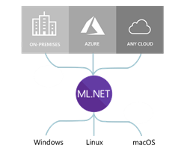
ML.NET runs anywhere
Supported Frameworks:
.NET Core (Natively)
.NET Framework (Natively)
Python with NimbusML (Python bindings)
Supported processor arch.
x64
x86

Slide 7
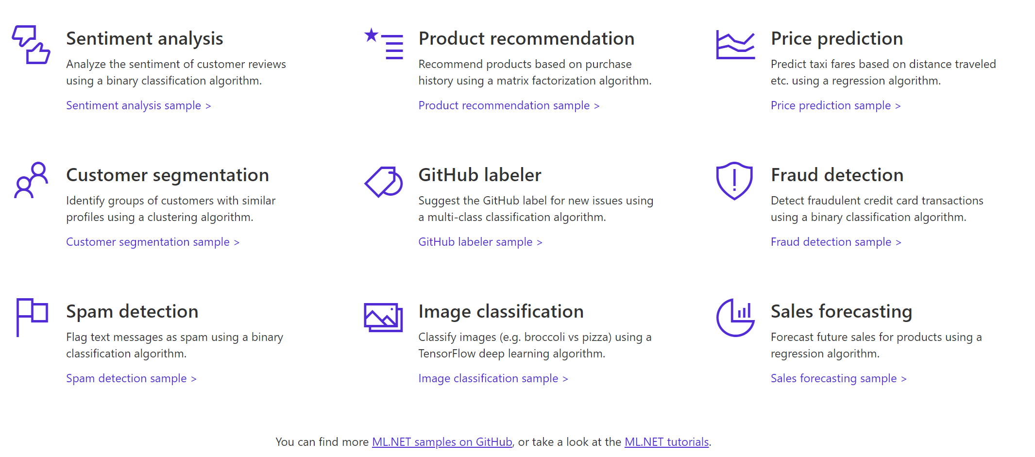

A few things you can do with ML.NET …
And more! Samples @ https://github.com/dotnet/machinelearning-samples
Notes:
So here’s an example of a few things you can do today with ML.NET 1.0
You can perform Sentiment Analysis, build Product recommenders,
forecast sales,
classify images and do a whole lot more.
And for all these scenarios we have provided you sample code for building and consuming these models, let me show you.
____
Dot.net
Here’s our dot.net/ml page which talks about some of the value props I mentioned, heres a list of samples.
So here is our samples repo, Here we have many samples for each ML task e.g. Fraud Detection for classification, Issue Classification, Sales Forecast etc.
For each of these samples we also provide you both the training code and consumption code along with explaining you how we built them
Alright so let me show you one of these samples live.
Here I have the sentiment analysis + blazor application

Slide 8




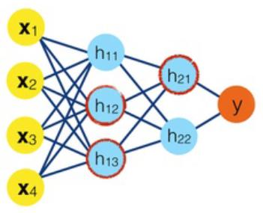



Machine Learning Workflow
Datasets
ML model
ML model
Prepare Your Data
Build & Train
Run
App/tools for training
the ML model
End-user app
using the ML model
Model creation
Model consumption
Notes:
3 main steps
Preparing your data – labeling, merging different data sources, cleaning up the data, and data transformations
Feed prepared data to algorithm and train the model (using algorithm with the data)
Consume model
TALKING POINTS:
There are two very different applications and contexts:
Prepare Data and Train the model Happens at development/research time, in your private app & tools for building the model
You run the model in the end-user application

Slide 9


Three ways to use ML.NET…
C#
>_
ML.NET
API
(Code)
ML.NET
Model Builder
(Visual Studio UI)
ML.NET
CLI
(Command-Line Interface)

Slide 10
Easiest way to create an ML.NET model: Model Builder in Visual Studio

Slide 11
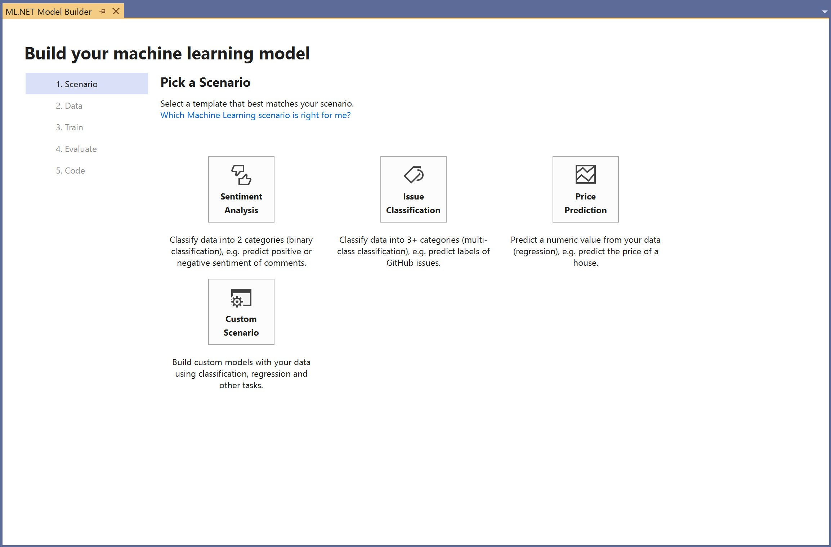
ML.NET Model Builder
Approachable machine learning in Visual Studio
A simple UI to easily build custom ML models with Automated ML
Load from files and databases
Generate code for training and consumption
Run everything local
Download VS vsix:
http://aka.ms/mlnetmodelbuilder

Slide 12
Demo 1: Model Builder in Visual Studio

Slide 13
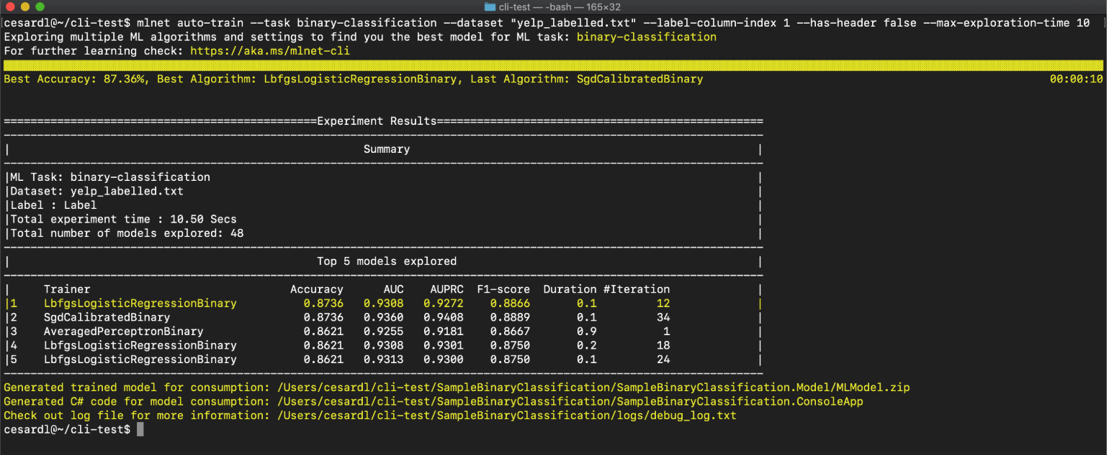
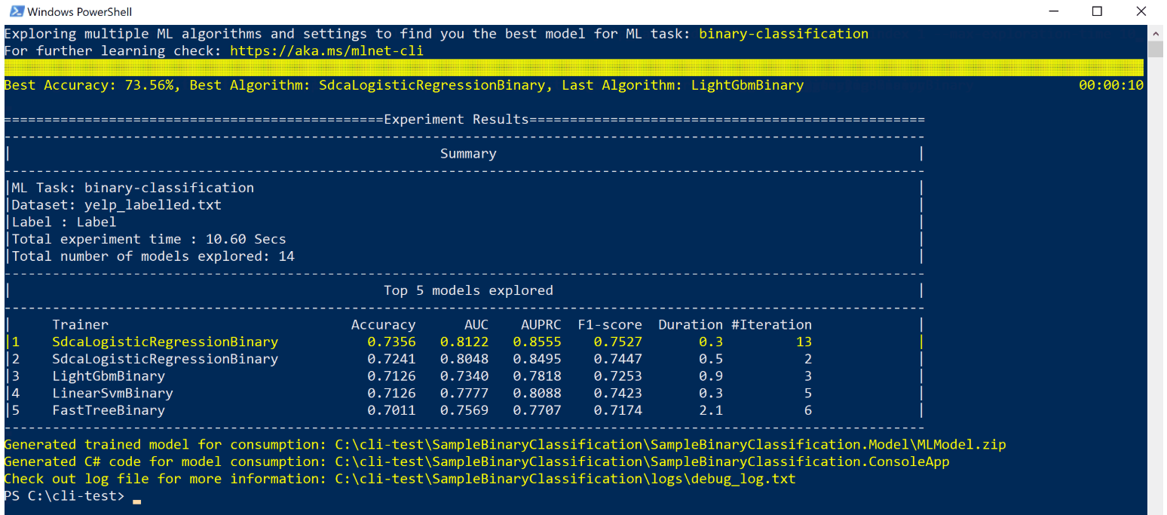
ML.NET CLI
Use the CLI to easily build custom ML models with Automated ML
Cross platform (Windows, Linux, MacOS)
Generate code for training & consumption
macOS / Linux (Bash)
Windows (PowerShell and CMD)
> mlnet auto-train --ml-task binary-classification --dataset "customer-reviews.tsv" --label-column-name Sentiment

Slide 14
What’s new in ML.NET since May 2019?

Slide 15
What’s new for data reading: Database Loader

Slide 16

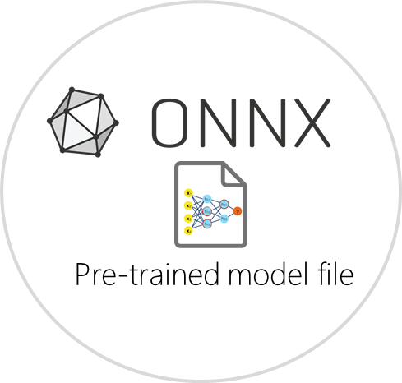
Database Loader
Enabled scenarios
Training directly against relational databases.
Simple and out-of-the-box code
Supports any RDBMS supported by System.Data
Currently in preview (1.4-preview release)
Relational
database
C# Training code
creating a ML model
Train on
SQL Server
Oracle
PostgreSQL
MySQL
etc.

Slide 17
Demo 2: Database Loader

Slide 18
What’s new for Deep Learning in ML.NET

Slide 19


Use Deep Learning models with ML.NET
Add intelligence based on DNN-based models to your .NET apps
Enables computer vision and many more Deep Learning domains
Image (input)
Dog
Not a dog
Dog
Not a dog

Slide 20



Leading libraries in deep learning and interoperability
PyTorch
Microsoft’s strategy is to integrate those low level libraries and runtimes into ML.NET:
Currently supported by ML.NET:
- TensorFlow
- ONNX
In ML.NET long-term roadmap:
- Torch

Slide 21
Leading deep learning ‘pre-trained models’ (DNN architectures)
Computer Vision
Audio and speech
NLP (Natural language processing)
Image classification
Wavenet
espnet
waveblow
deepspeech2
loop
tacotron
etc.
Google InceptionV3
Microsoft ResNet
NASNet
Oxford VGG Model
MobileNetV2
etc.
Generative Models
… other domains …
Object detection
Yolo (You Only Look Once)
R-CNN
SPP-net
Fast R-CNN
Faster R-CNN
etc.
Huge investment/cost in DNN architecture research plus costly training on large datasets made by organizations such as Google, Microsoft, Facebook, Universities and researchers.
You can take advantage of it by simply consuming pre-trained models
https://modelzoo.co/categories
Notes:
https://modelzoo.co/categories
https://cv-tricks.com/object-detection/faster-r-cnn-yolo-ssd/

Slide 22


Consuming pre-trained deep learning models with ML.NET Scenario: Image classifier (Consuming the model)
Pre-trained
Deep learning model
(i.e. Image classifier)
“dog”
“elephant”
“flower”
“person”
“car”
Pre-defined list of
generic labels
Examples of pre-trained models (Image classifiers):
Google Inception v3, NASNet
Microsoft ResNet
Oxford VGG Model, etc.
GitHub sample here
Notes:
An image classifier is a deep learning model that recognizes images. When you give it an image, it responds with a label for that image.
NASNet: https://ai.googleblog.com/2017/11/automl-for-large-scale-image.html

Slide 23
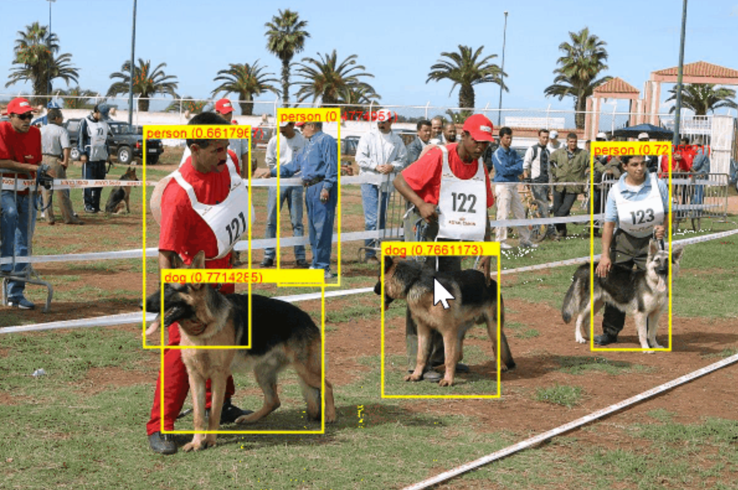

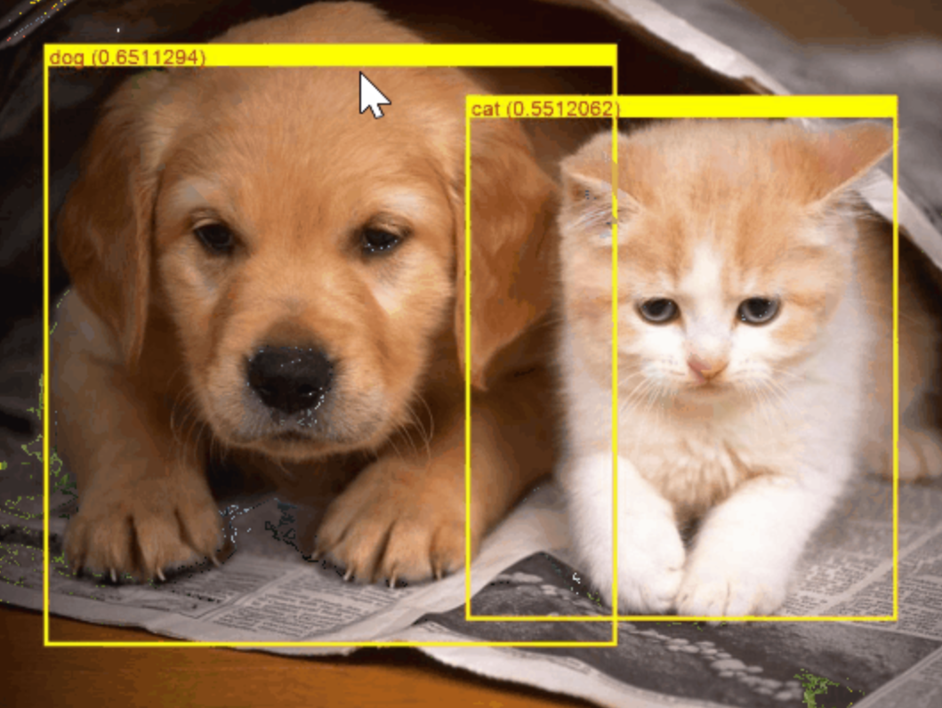

Consuming pre-trained deep learning models with ML.NET Scenario: Object Detection (Consuming the model)
Pre-trained
Deep learning model
(i.e. Object Detection)
Examples of pre-trained
models for obj. detection:
YOLO (You Only Look Once)
Faster R-CNN
SSD, etc.
GitHub sample here
Notes:
An image classifier is a deep learning model that recognizes images. When you give it an image, it responds with a label for that image.
NASNet: https://ai.googleblog.com/2017/11/automl-for-large-scale-image.html

Slide 24
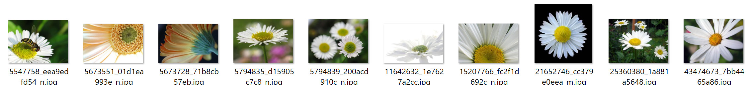
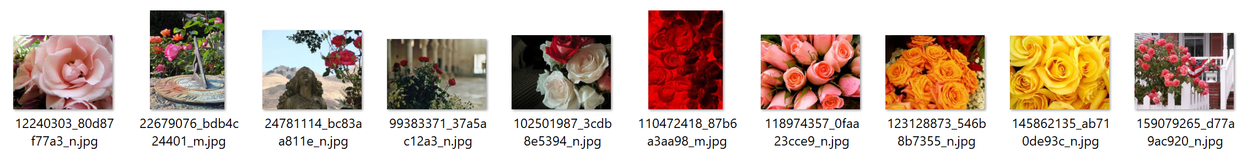

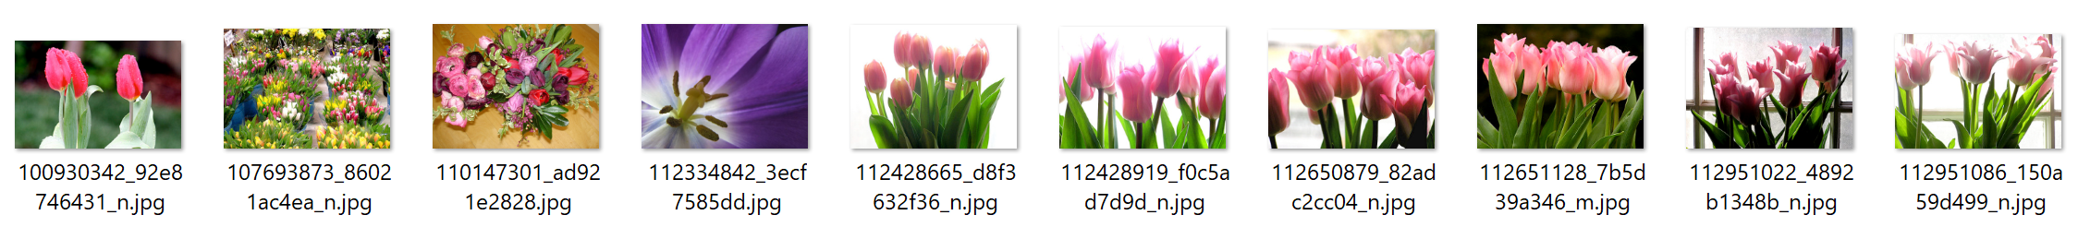
What if I want to classify based on my own custom domain? Scenario: Image classifier (Training)
Then you train your own custom deep learning model with ML.NET
“daisies”
Your custom Image Classifier
(Deep learning model)
“roses”
Train
“tulips”
When training, ML.NET is based on TensorFlow underneath (Transfer Learning).
ML.NET currently supports “ImageClassifier training” ( Preview)
Object Detection training will come soon
Notes:
An image classifier is a deep learning model that recognizes images. When you give it an image, it responds with a label for that image.
NASNet: https://ai.googleblog.com/2017/11/automl-for-large-scale-image.html

Slide 25
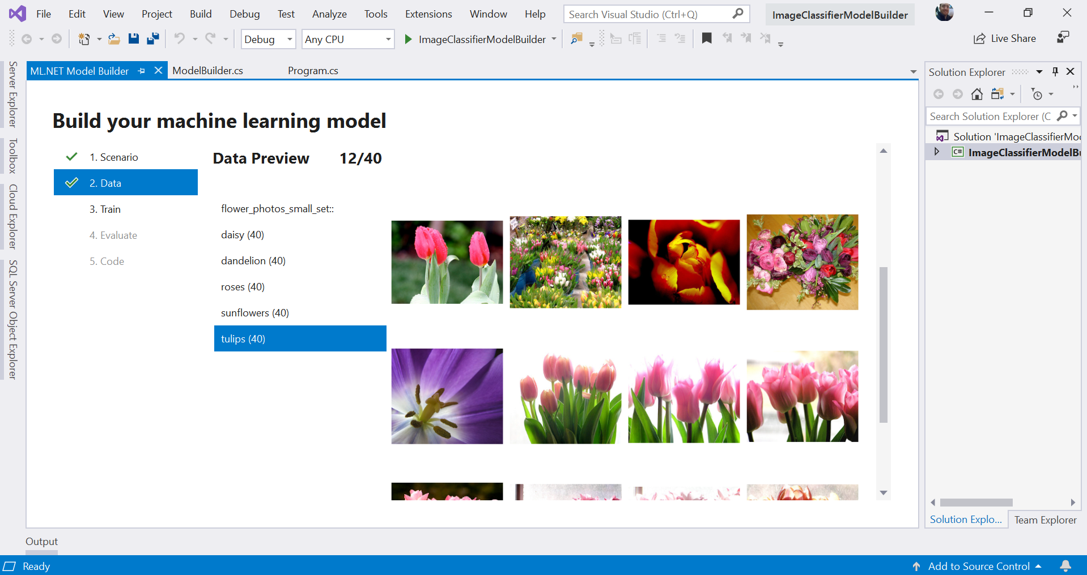
Image Classification in ML.NET Model Builder (VS extension)
A simple UI to easily build custom ML models with Automated ML
Directly load image folders
Generate code for training and consumption
Run everything local
(*) The Image Classifier feature in Model Builder will be public preview in upcoming releases.
As of Sept. 23rd 2019 this feature is still not publicly released in Model Builder, yet.
You can already use the API in public preview, though.
Notes:
An image classifier is a deep learning model that recognizes images. When you give it an image, it responds with a label for that image.
NASNet: https://ai.googleblog.com/2017/11/automl-for-large-scale-image.html

Slide 26
Demo 3: Training custom Deep Learning models with Model Builder - Image Classification task (Preview)

Slide 27

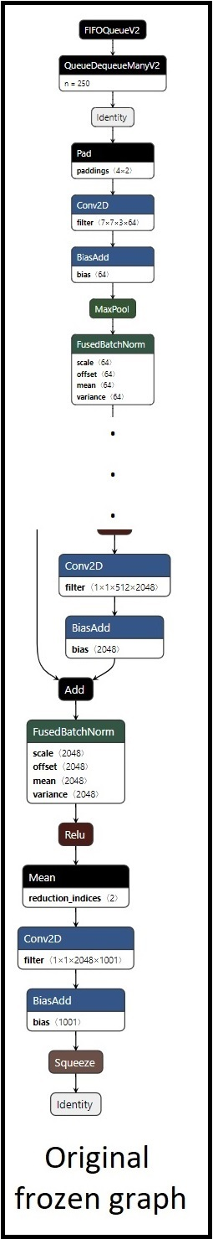
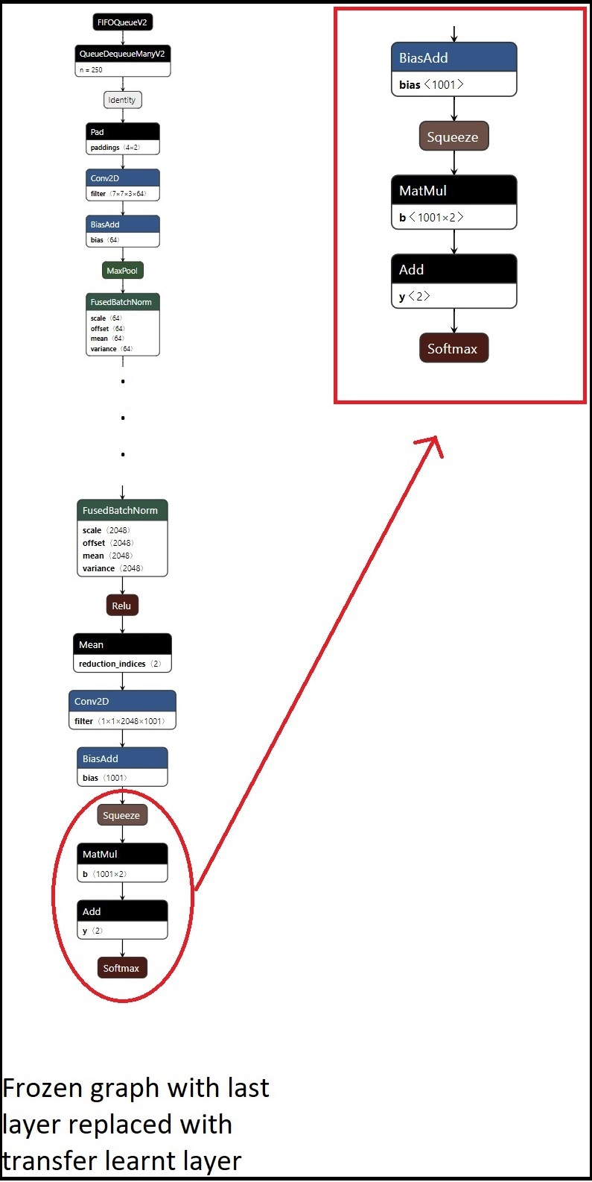
Transfer learning in TensorFlow with ML.NET ImageClassifier
(Preview)
Benefits:
Native DNN transfer learning: Transfer Learning happens within TensorFlow DNN models, not using ML.NET trainers on-top
Best power and optimization: We’re able to re-train one or more layers within the TensorFlow graph
Pre-trained
TensorFlow model
DNN graph
(i.e. Inception, ResNet, etc.)
Final trained custom
TensorFlow model
DNN graph
(With Transfer learning)
Original
Pre-trained
.meta file
Re-trained
graph
Transfer
Learning
Re-train
Internal dependencies for TensorFlow
Dependency on TensorFlow.NET bindings for C#
Dependency on native TensorFlow binary redist.
Frozen graph with last layer replaced with the transferred learning layer with the new re-training
Notes:
SPECS: https://github.com/dotnet/machinelearning/blob/cd591dd492833964b6829e8bb2411fb81665ac6d/docs/specs/DNN/dnn_api_spec.md

Slide 28

Transfer learning in TensorFlow with ML.NET ImageClassifier
(Preview)
Simplification benefit: High level API oriented to ML Task: ‘ImageClassification’
Pre-trained
TensorFlow model
DNN graph
(i.e. Inception, ResNet, etc.)
Final trained custom
TensorFlow model
DNN graph
(With Transfer learning)
ML.NET pipeline creating a new re-trained TensorFlow Model through Transfer Learning within TensorFlow
var pipeline = mlContext.Transforms.Conversion.MapValueToKey("Label")
Re-trained
graph
.Append(mlContext.Model.ImageClassification("Image", "Label",
arch: DnnEstimator.Architecture.InceptionV3));
var trainedModel = pipeline.Fit(trainDataset);
Original
Pre-trained
.meta file
Transfer
Learning
Re-train
New TensorFlow model
Retrained with Transfer Learning
(.pb file)
New ML.NET model
As simple wrapper for execution from .NET
(.zip file)
Frozen graph with last layer replaced with the transferred learning layer with the new re-training
End-user C# app
Scoring/predicting
with model
C# app
Final
re-trained
.pb file
Blog Post: Training Image Classification/Recognition models based on Deep Learning & Transfer Learning with ML.NET
Notes:
SPECS: https://github.com/dotnet/machinelearning/blob/cd591dd492833964b6829e8bb2411fb81665ac6d/docs/specs/DNN/dnn_api_spec.md

Slide 29
Demo 4: Training custom Deep Learning models with ML.NET (NEW transfer learning based API) - Image Classification task (Preview)

Slide 30
What’s new for Data exploration, ML experimentation and learning-oriented formats

Slide 31
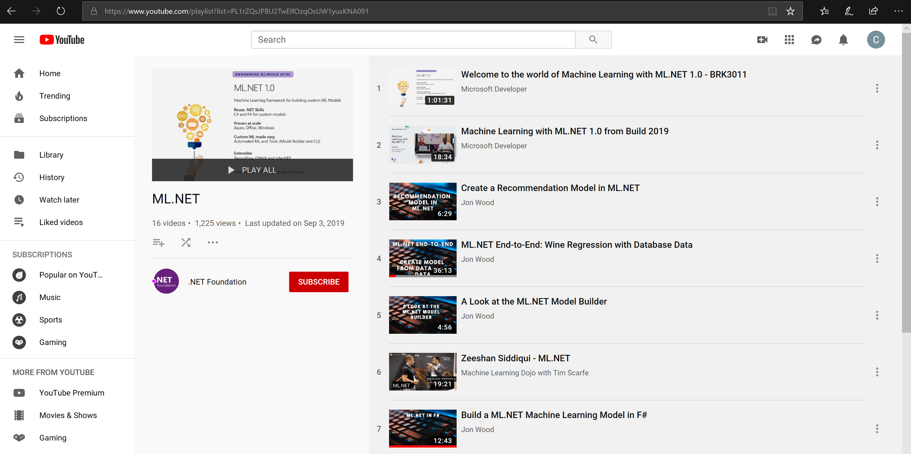
Other important features in ML.NET
DevOps & ML Model lifecycle with Azure DevOps CI/CD pipelines
Model Explainability and Feature input variables importance
Cross-validation of ML.NET models:
Loading data from ‘anywhere’ through the LoadFromEnumerable() method
Using huge and sparse datasets (thousands or millions of columns)
Deploy ML.NET model into high scalable and multi-threaded ASP.NET Core apps and services
Deploy ML.NET model into an Azure Function
Plus many more ML Tasks and scenarios (see samples here: https://github.com/dotnet/machinelearning-samples ) such as:
Sentiment analysis, Spam detection, Fraud Detection, text classification, products recommendations, data spike detection, clustering, ranking results, etc.
Check out many of those scenarios at the ML.NET YouTube playlist:
https://aka.ms/mlnetyoutube

Slide 32
Roadmap ahead
Introducing deep learning model training (Preview)
Image classification & object detection
Adding database loader (Preview)
Improvements for ML.NET on Jupyter
Scale-out on Azure for training and consumption
Improve AutoML experience for all ML scenarios
Improve tooling in Visual Studio and .NET (Model Builder & CLI)
ARM and ONNX support (Enablers for Xamarin & IoT scenarios)

Slide 33

ML.NET Resources
Get started at http://dot.net/ml
Try the samples at http://aka.ms/mlnetsamples
Read the docs at http://aka.ms/mlnetdocs
Watch ML.NET videos at https://aka.ms/mlnetyoutube
Request features or contribute at http://aka.ms/mlnet

Slide 34
Thank you! ☺
Cesar de la Torre
Principal Program Manager
.NET & ML.NET teams
Twitter: @cesardelatorre

Slide 35
Backup slides

Slide 36














Your platform for building anything
DESKTOP
WEB
CLOUD
MOBILE
GAMING
IoT
ML
.NET
Notes:
.NET is a great tech stack for building a wide variety of applications. There is ASP.NET for web development, Xamarin for mobile development and with ML.NET we are trying to make .NET great for Machine Learning.

Slide 37










ML.NET is enterprise-ready battle proven
Microsoft Products
(Using ML.NET internally for > 8 years)
Customers
(ML.NET v1 since May 2019)
Bing - Ad Predictions
Evolution Software – Hazelnut drying time prediction
Excel - Chart Recommendations
Williams Mullen – Law document classification
Power Point - Design Ideas
Sig Parser – E-mail spam detection
Microsoft Defender – Antivirus Threat Protection
Brenmor – Medical patient survey classification
Azure ML Studio – Multiple components
Azure Stream Analytics - Anomaly Detection
endjin – Newsletter article classification
+ more

